Slide 1
Software: Ultrasound In Nepal

Slide 2
Software: Ultrasound In Nepal
Purpose:
Allow maternal patients in remote areas of nepal have access to medical experts and advice in pregnancy period.
Allow Fieldworkers to collect medical information from maternal patients and share it with medical experts(radiologists).
Allow Medical Experts to remotely look at maternal patient’s details and ultrasound information shared by the fieldworker and provide professional medical recommendations for patient’s treatment.

Slide 3
Purpose: Continued
Allow Fieldworker to receive medical expert’s recommendation along with annotated visual response for individual patient and take further steps for well being of the patient.
Allow superuser (administrator) to create new accounts with access restrictions to information stored in database and manage all registered users in the system.

Slide 4

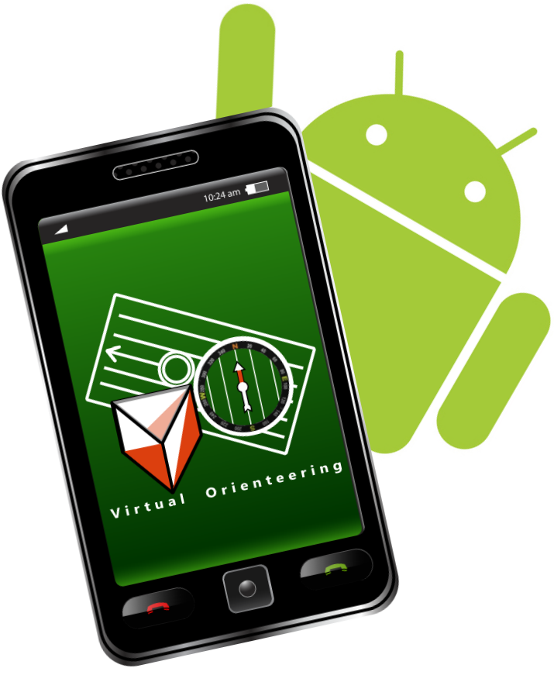

Software Design
Medical Response to fieldworker
Database (Info about: Patients and users.
Medical Response
Android Client to Collect and send patient’s medical details.
Java Client to receive and view patient’s medical details and send back a response.
Medical Details and condition of patient.

Slide 5
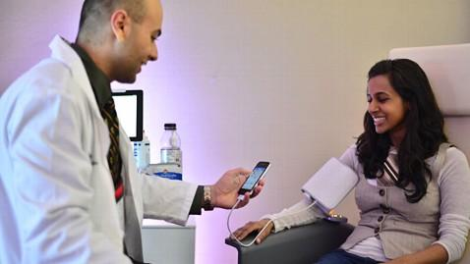
Process of Software In Use: Phase 1
Fieldworker collects information about maternal patient and sends it to database over network using Android Application.

Slide 6
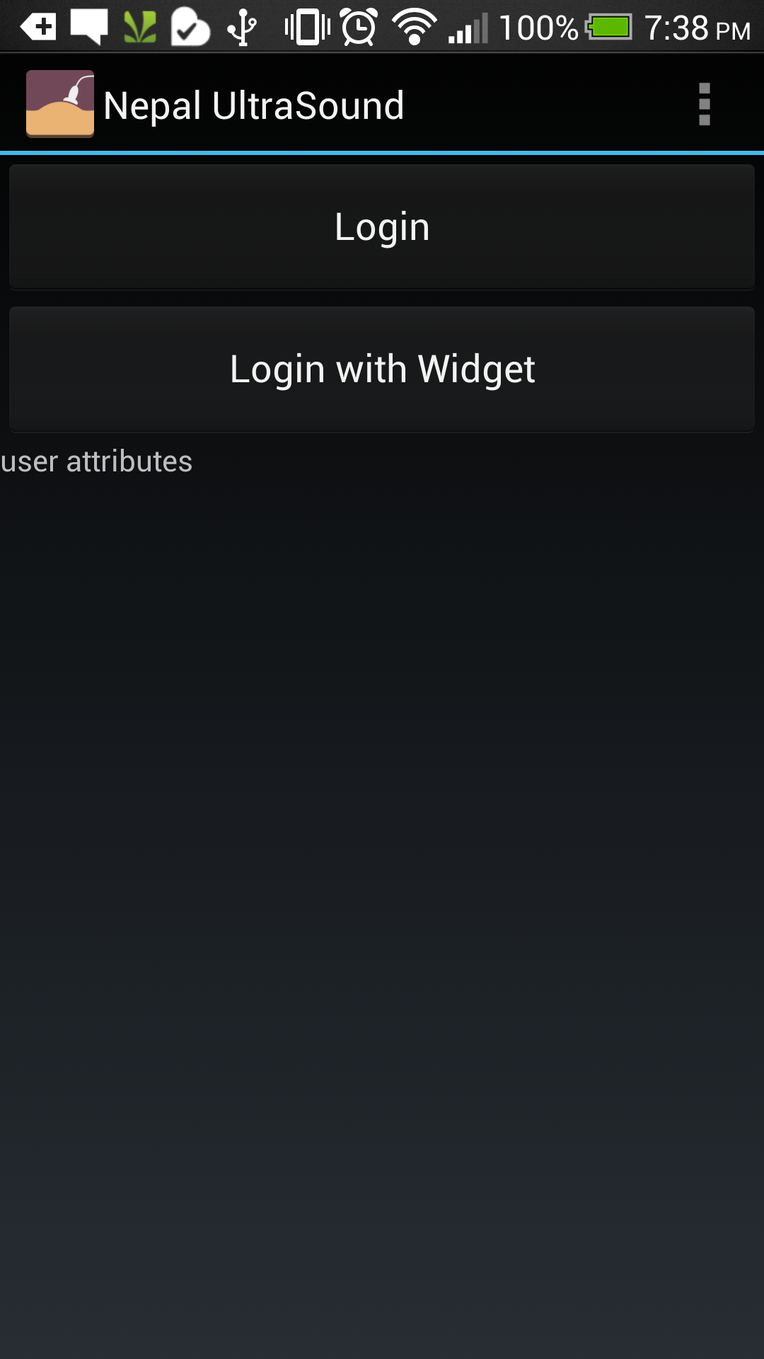
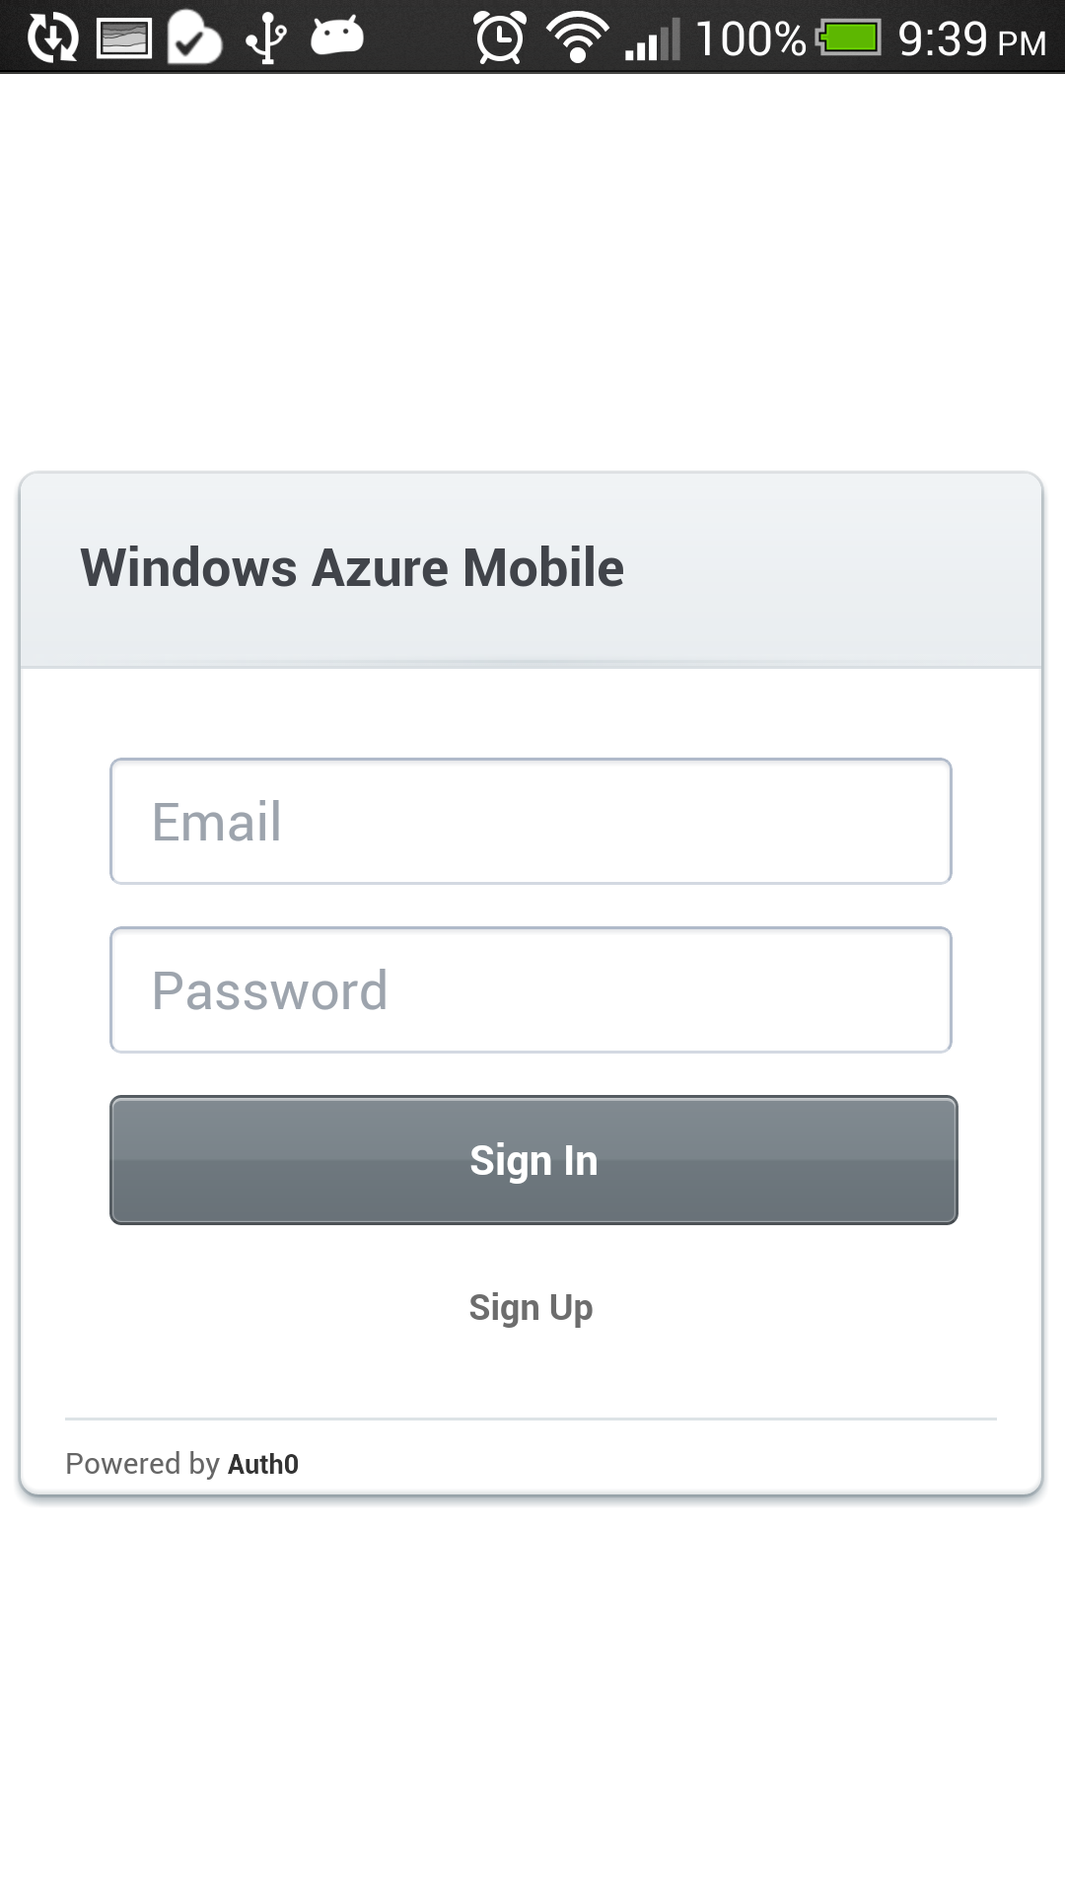

Slide 7
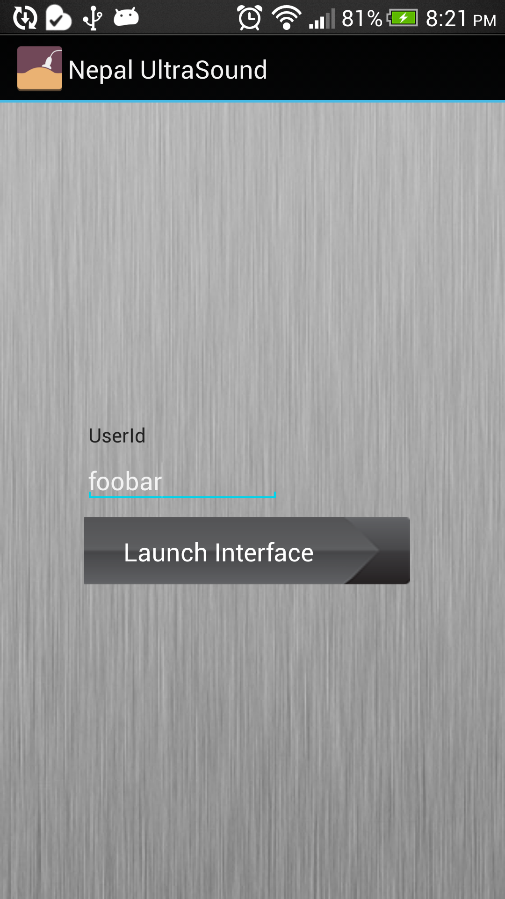
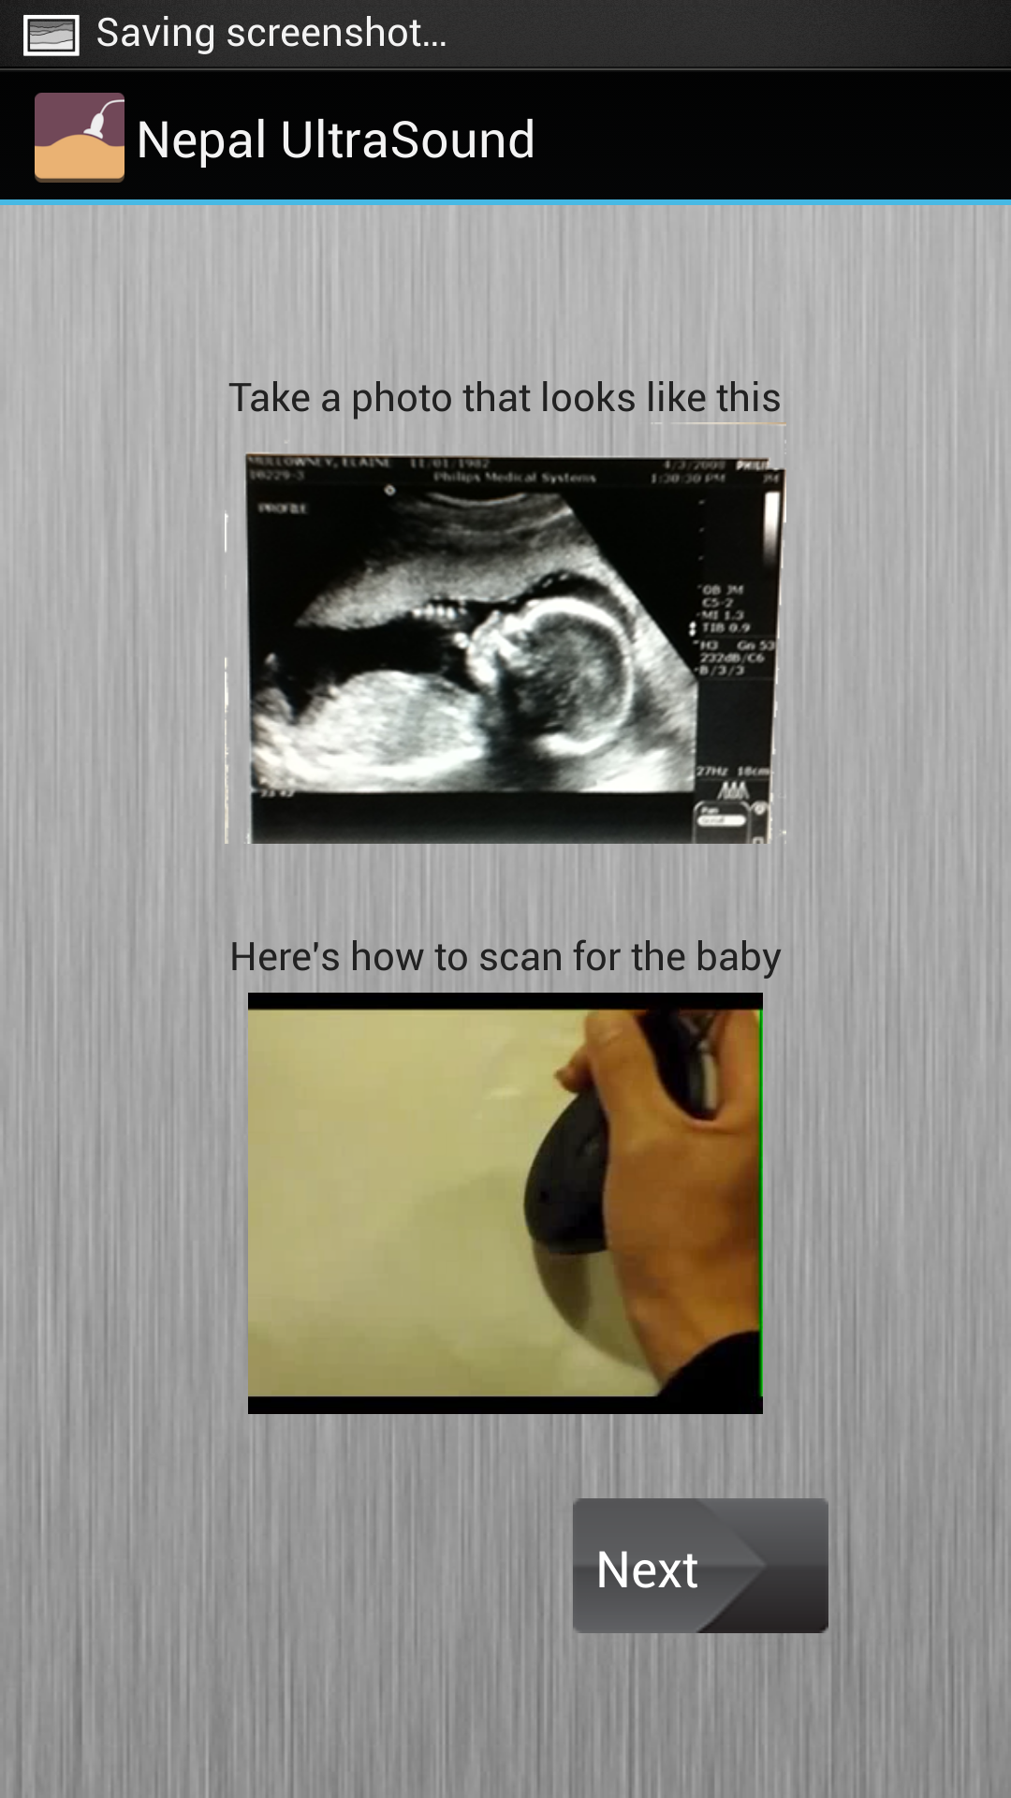

Slide 8
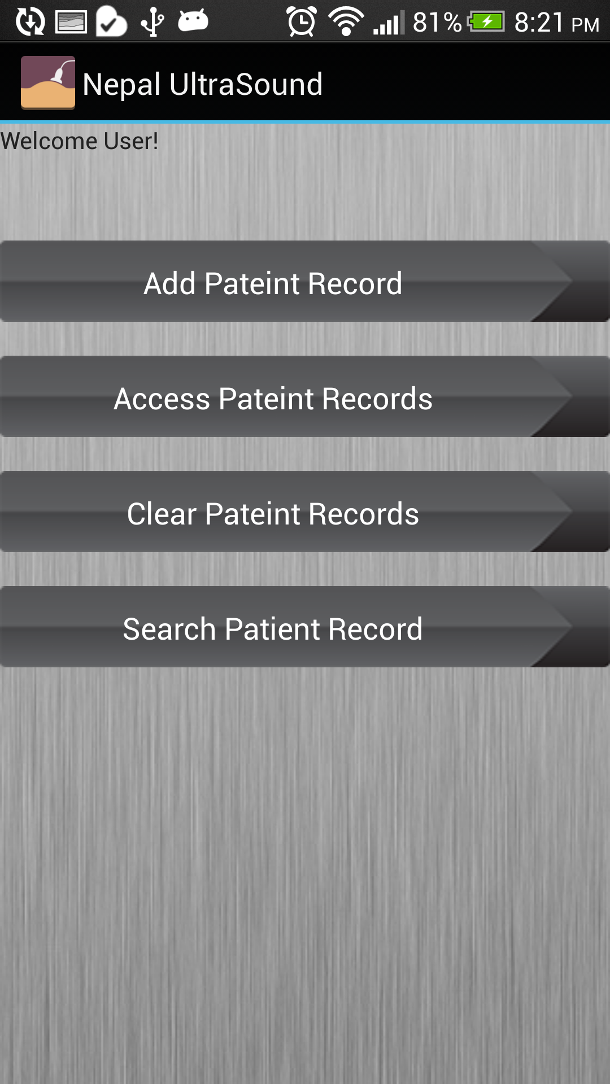
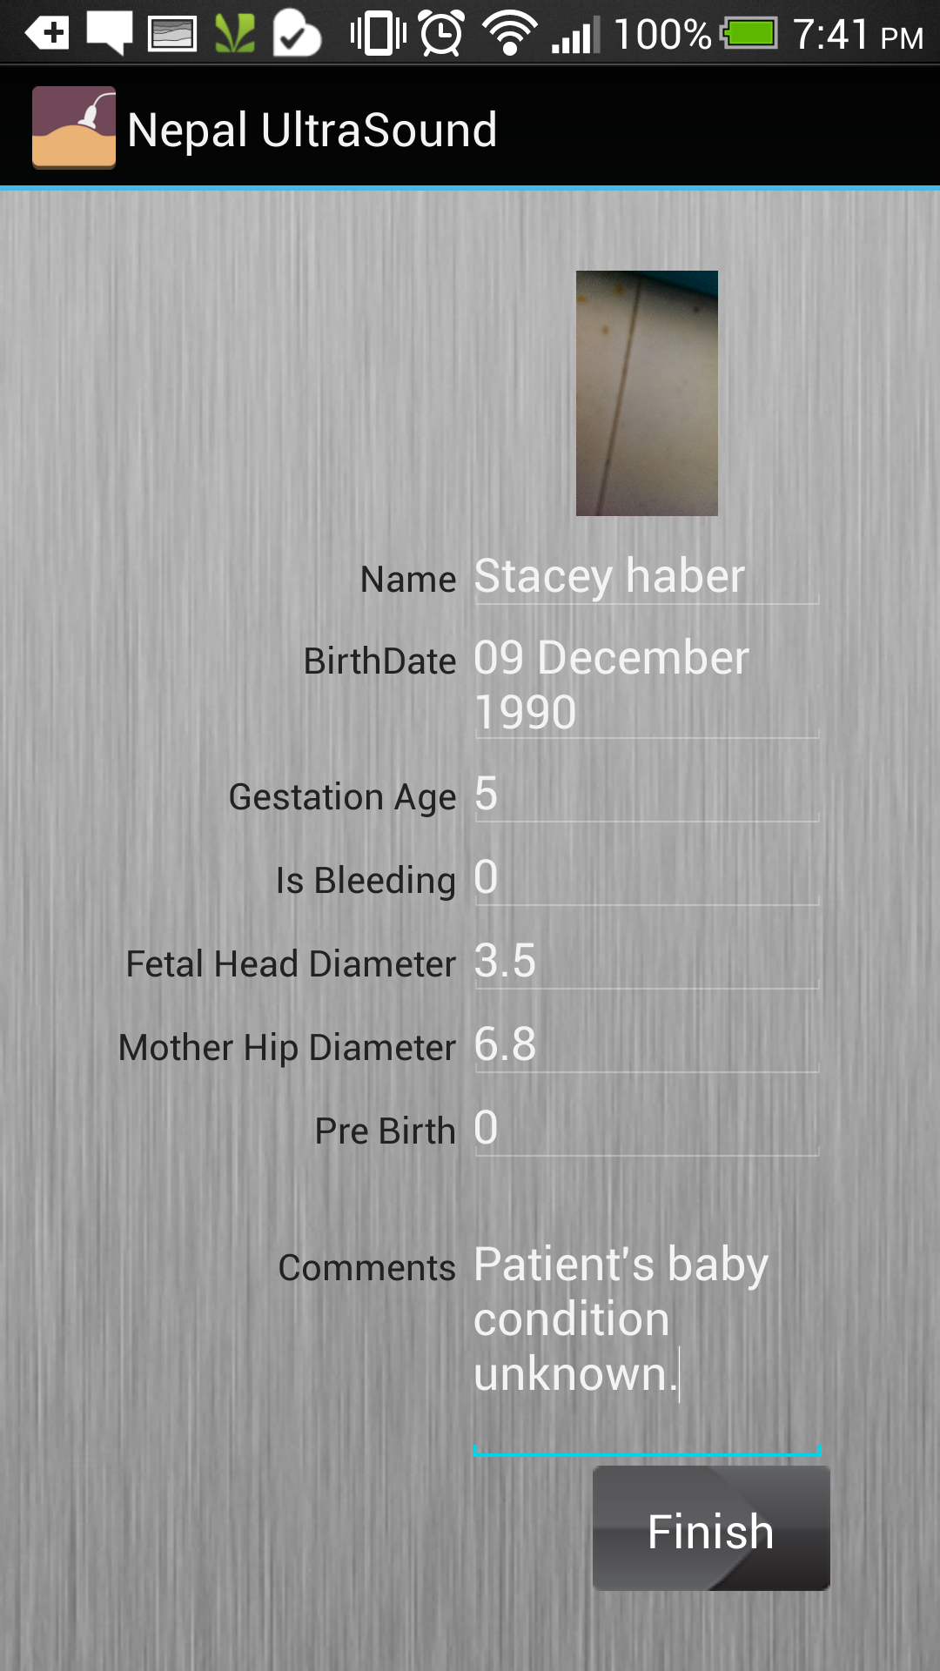

Slide 9
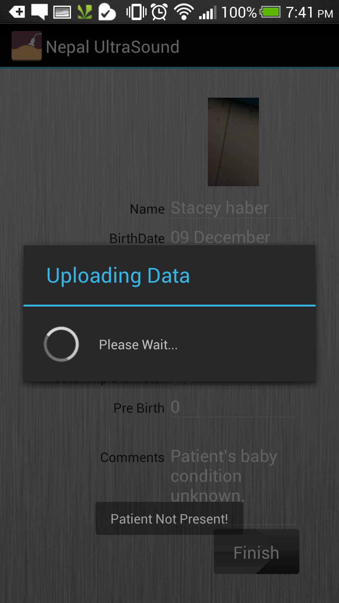
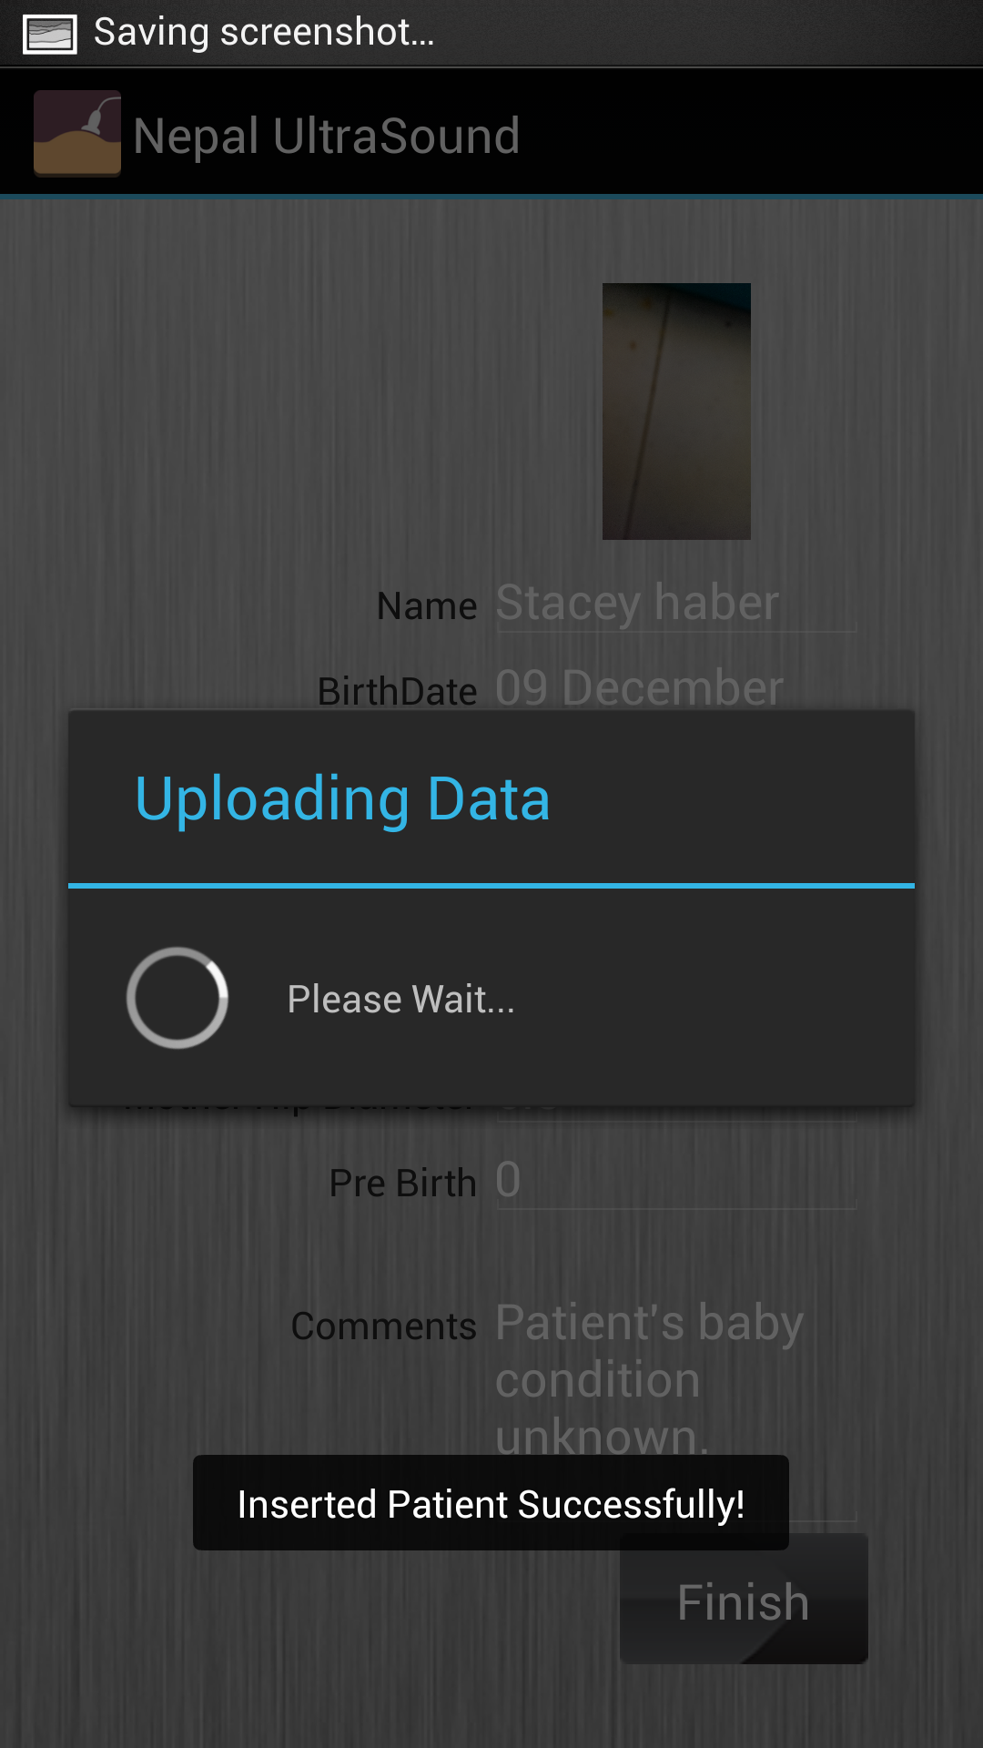

Slide 10
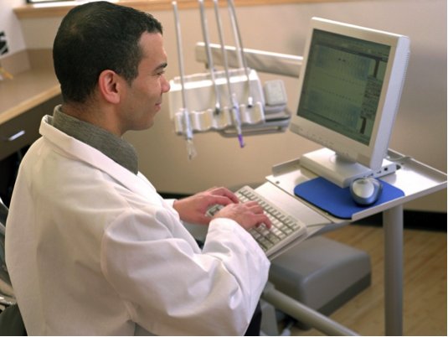
Radiologist: Receive Medical Details
Radiologist receives medical details along with ultrasound image.
Then a medical recommendation specific to patient, along with annotated image is sent back.

Slide 11
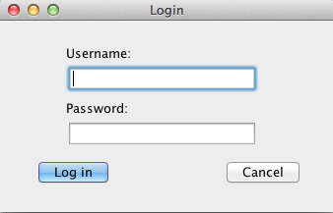
Radiologist Logs In

Slide 12
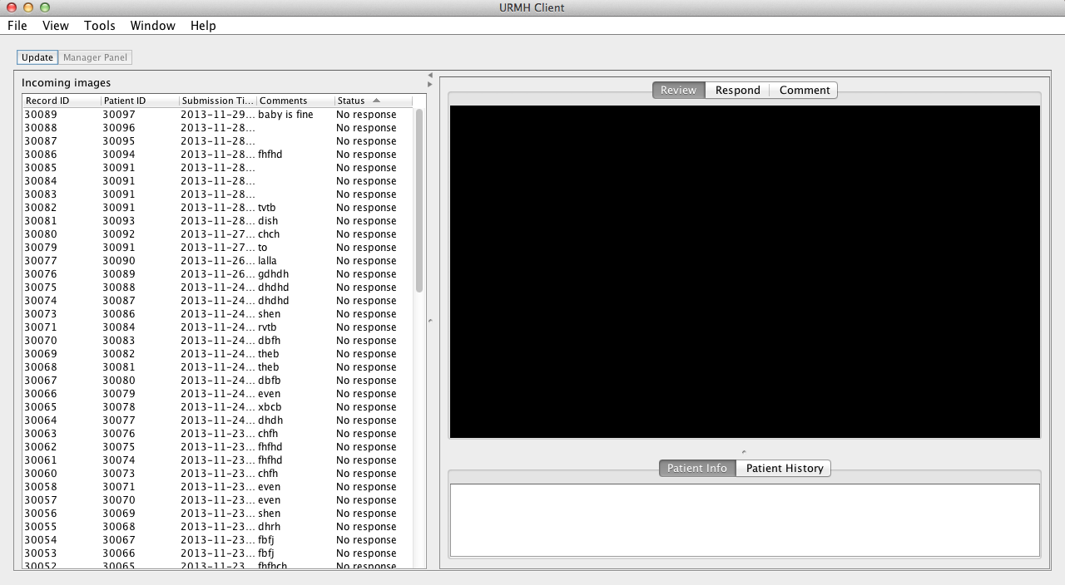

Slide 13
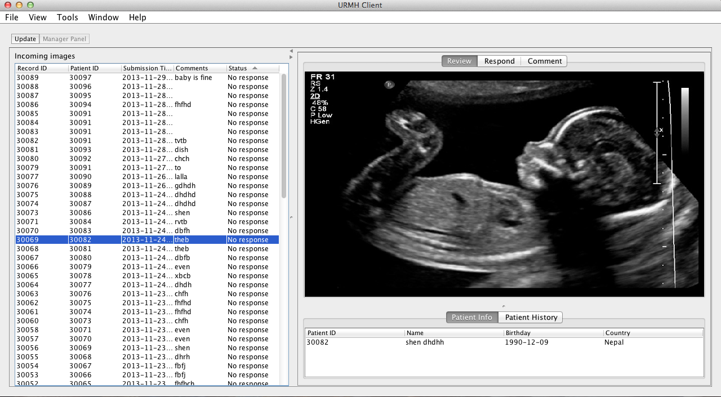

Slide 14
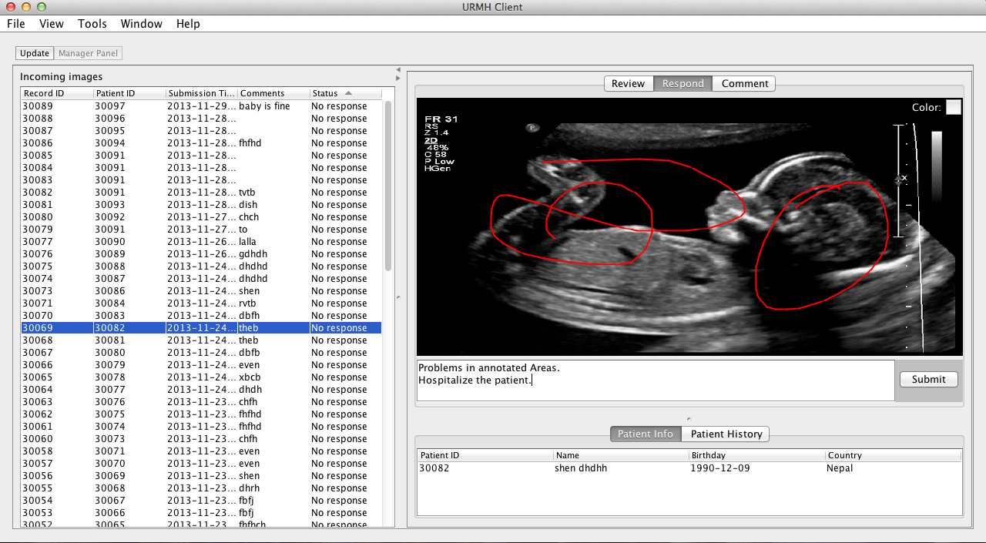

Slide 15
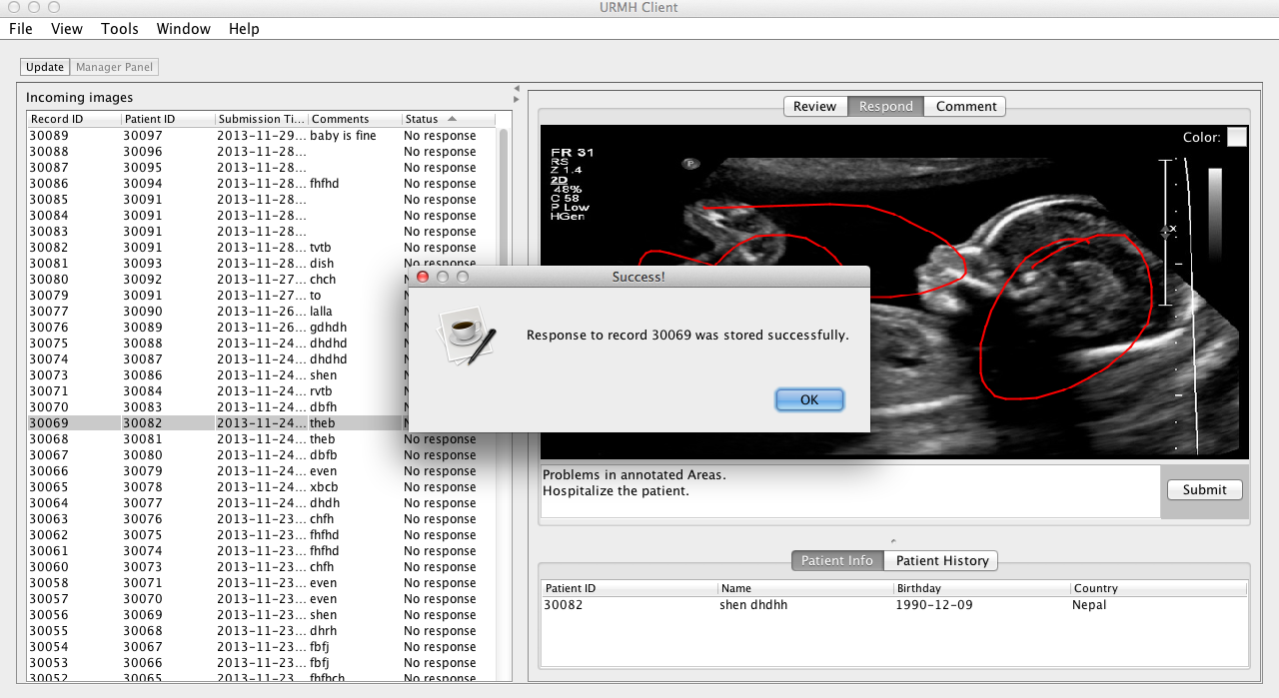

Slide 16

Fieldworker: Receive Response
Fieldworker receives response for individual patient from radiologist along with annotated ultrasound image.

Slide 17
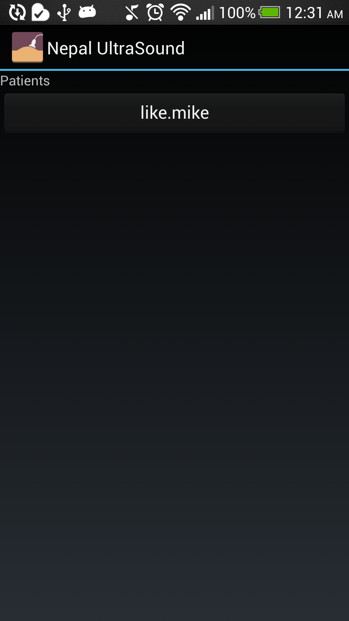
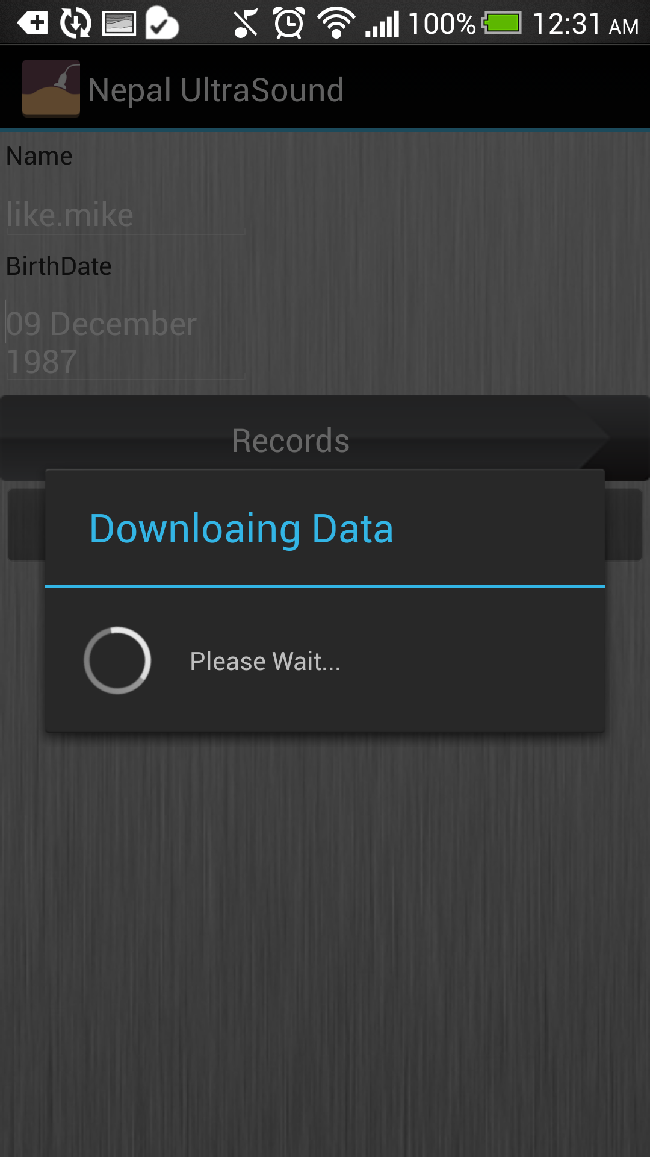

Slide 18
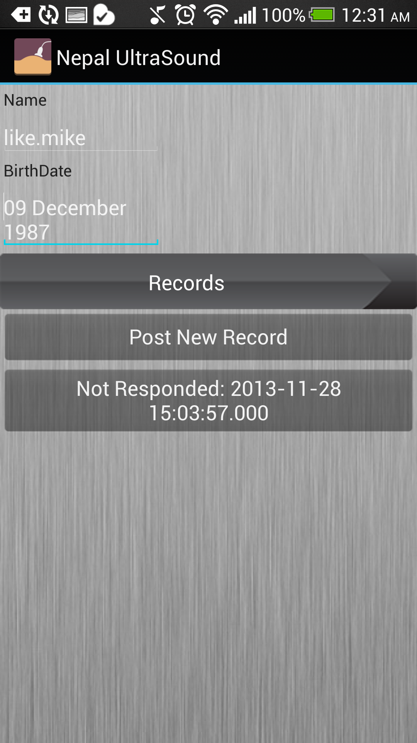
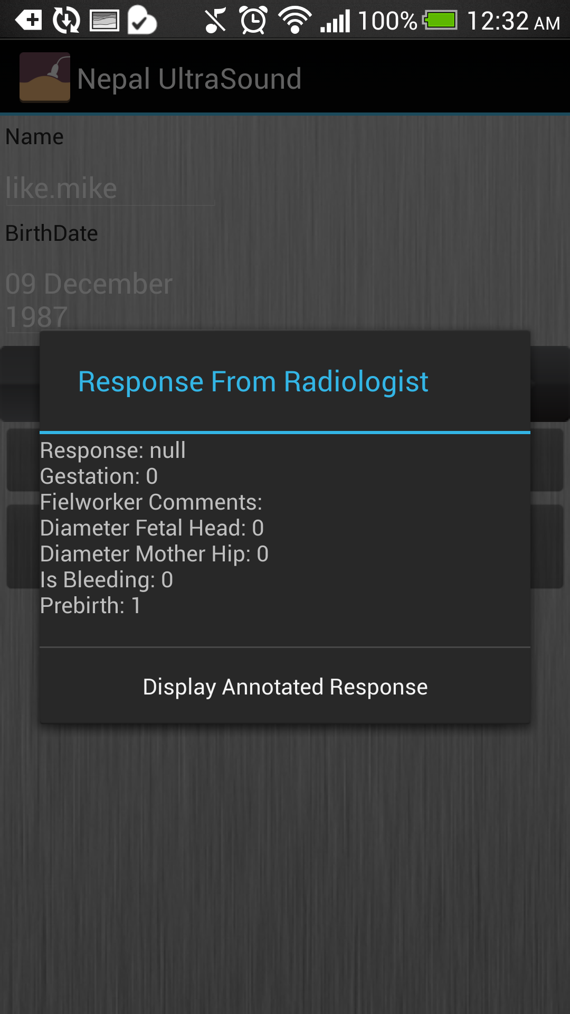

Slide 19
Additional Features
Security:
User Name and Password Encrypted.
SSL secure layer added to website.
Efficiency:
Images are compressed to 80% of original size before transfer from both clients.
Management:
Register new users to access software online using website.
Password Recovery support.

Slide 20

Technologies Used
Android Application:
Programming Language: Java
IDE: Eclipse
Library : Android API (SDK)
Android OS MIN Version Required: 3.0
Database: MSSQL hosted on Windows Azure
Website: PHP 4.4 hosted on Windows Azure Server
Framework for web development: CodeIgniter
Standalone Java Client:
Library: Java API IDE: Eclipse Language: Java

Slide 21
End of Presentation
Thank You.

